Slide 1
Interview_Stanford Federal Credit Union
Cindy Huang

Slide 2
E-Mail Marketing Campaign Performance Tracking https://github.com/yuanhsin8311/email-marketing-campaign

Slide 3
E-Mail channel conversion experiment (AB Test)
Define “number of distinct user who click-and-convert to apply Loan” as KPI
Question: time-limited sales pitch in subject line can get more conversion?
Determine sample size based on 0.05 significance level, minimum effect size, power, expected standard deviation of the change in metric
Based on sample size, determine 2 weeks-1 month to run AB test
Do Cohort Analysis to narrow down population size scope (if population is in large scale)
- Focus on 30 years, joint account, family income > $200K
- Home Mortgage fixed 30y 4.609% email campaign
Randomly split this groups as control and treatment group
Run t-test and use p-value to verify the difference between two versions
Cost analysis if the changes are worth to follow up

Slide 4
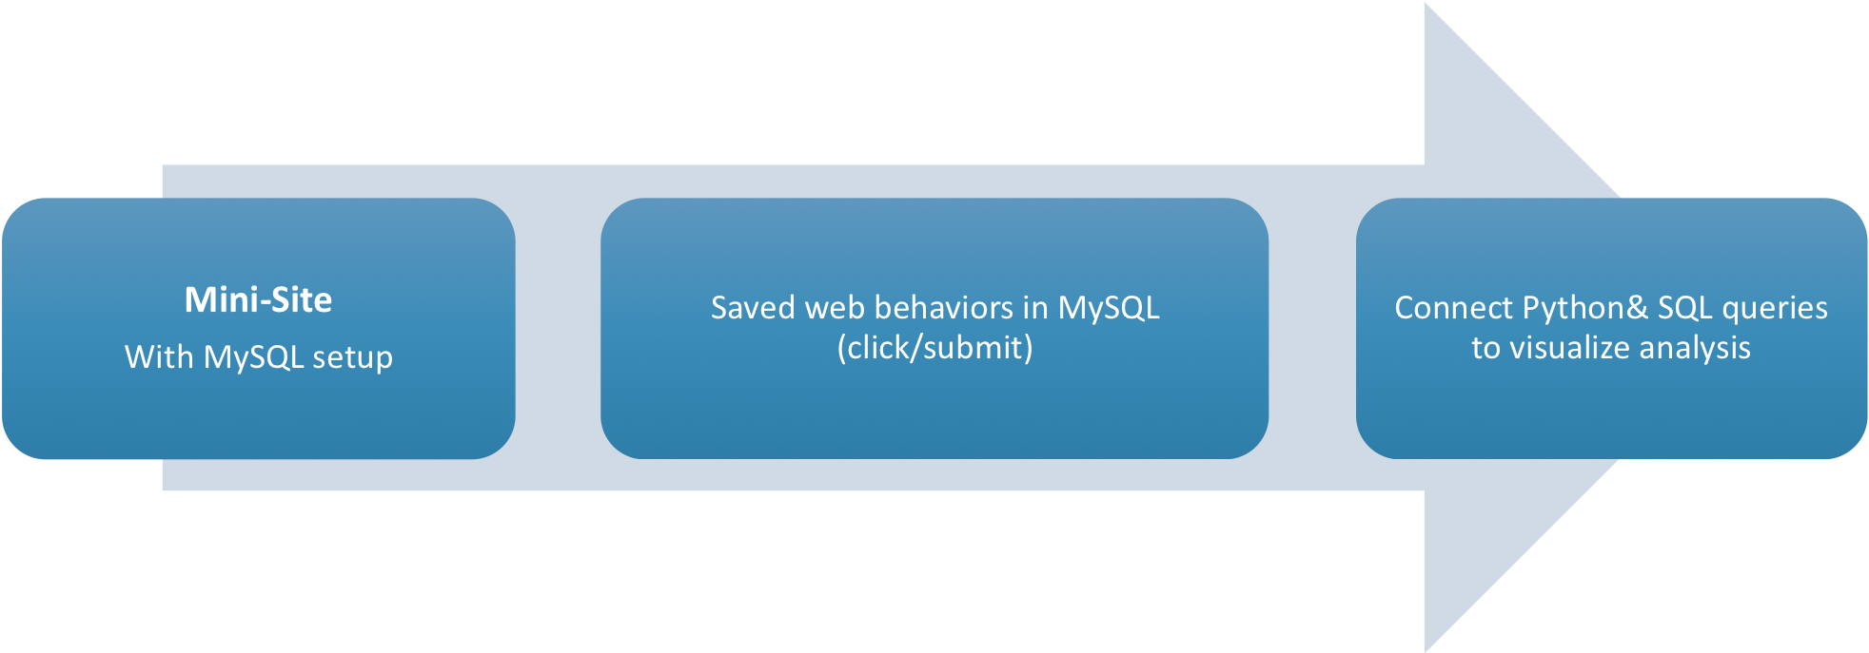
Get Data Workflow

Slide 5
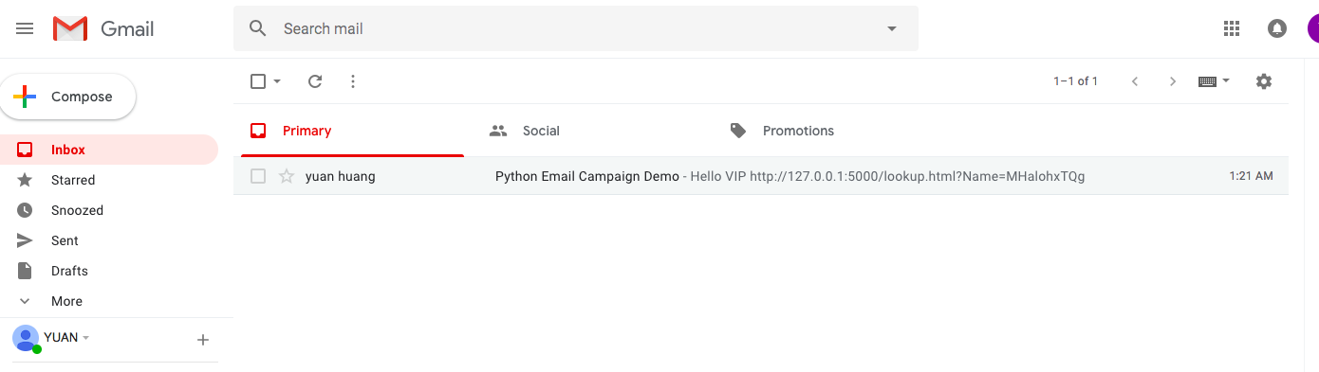
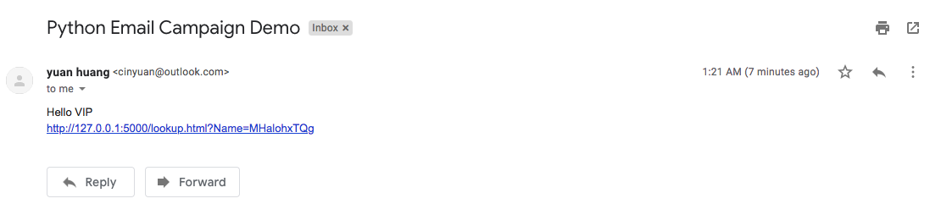
E-Mail Campaign Simulation: Send mails to TA via Python scripts

Slide 6
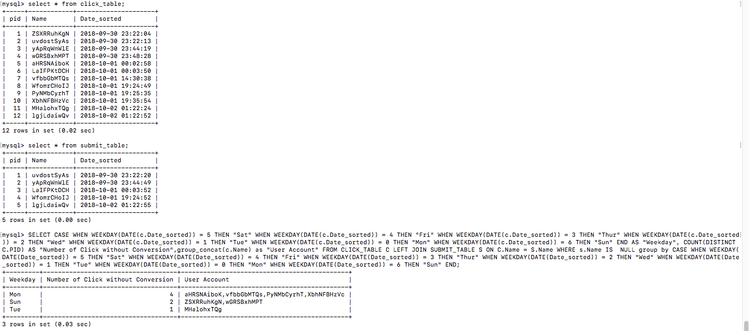
Get TA who clicked but didn’t apply loan (MySQL)

Slide 7
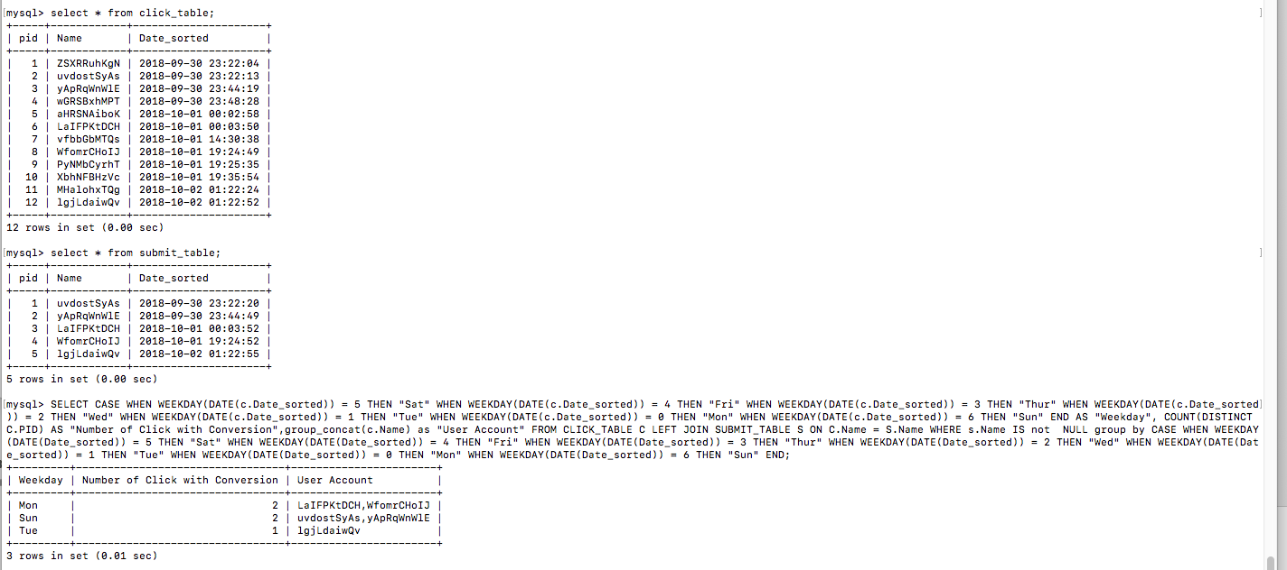
TA who clicked and were converted

Slide 8
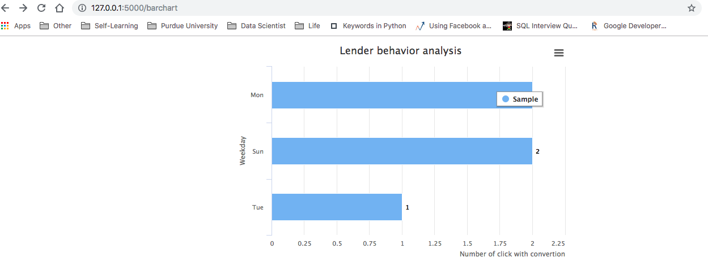
Visualize count of conversion

Slide 9
Appendix- open rate

Slide 10
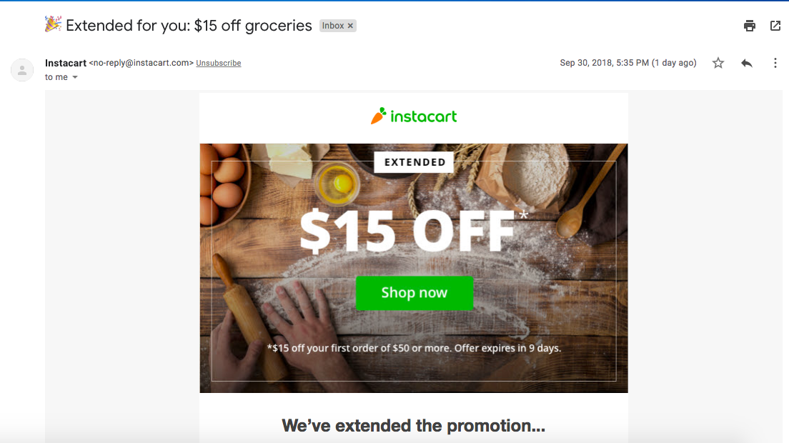
Example: Instacart promotion email

Slide 11
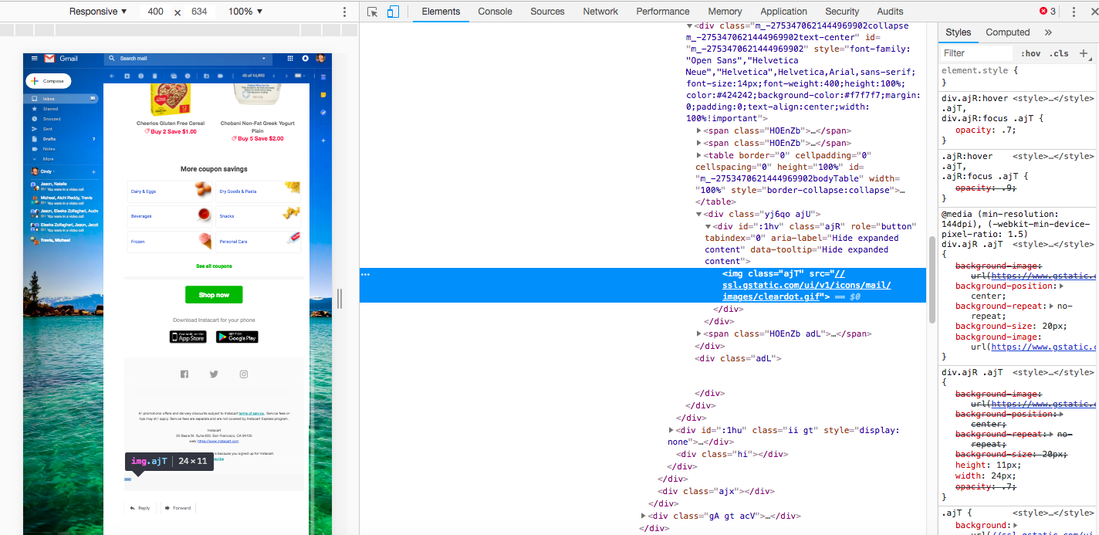
unseen gif img for tracking open rate

Slide 12
Thank You

